Slide 1
Lotka-Volterra predator-prey dynamics
Why do predators and prey cycle, and what stops them?
Notes:
Leave this up while students settle, then go straight to the next slide. The deck is reference only: no lecture (they have had Thomas's Predation 1 and 2). Students work from the online book; the slides show what they should see.
No title photo yet: drop a licensed photo (e.g. lynx and snowshoe hare) into the picture placeholder and record the credit here.

Slide 2
Work through the Lotka-Volterra predator-prey practical in the online book
2 SESSIONS · PAIRS
Session 1: Part 1 (build the model) and Part 2 (explore it)
Session 2: Part 3 (prey carrying capacity), Part 4 (prey refuge) and the four questions
Predict before you change anything
Check your work against the next slides
Notes:
Leave this slide up while students work. Everything they need is in the book chapter: the worksheet download, the prey formula for B12, the Part 2 tasks, Parts 3 and 4 and the questions.
Part 1 (about 10 min): predator formula in C12 is =MAX(0,C11+$F$8*($F$6*B11*C11-$F$7*C11)); copy to row 3011; check t = 1 gives (1050, 19.6). Common errors: missing $ signs; using a instead of c for predator births; forgetting dt.
Part 2 (about 25 min), answers: prey peak first, predators about a quarter of a cycle later, anticlockwise; equilibrium (1250, 25); dt = 1 prey extinct at t = 220, dt = 0.5 still grows, dt = 0.1 almost closed; doubling r, a, c, d moves P* to 50, 12.5 and H* to 625, 2500. Make sure every pair tries dt = 0.1.
Session 2: Part 3 formula =MAX(0,B11+$F$8*($F$4*B11*(1-B11/$F$9)-$F$5*B11*C11)), check t = 1 gives H = 925. Keep dt = 1.

Slide 3
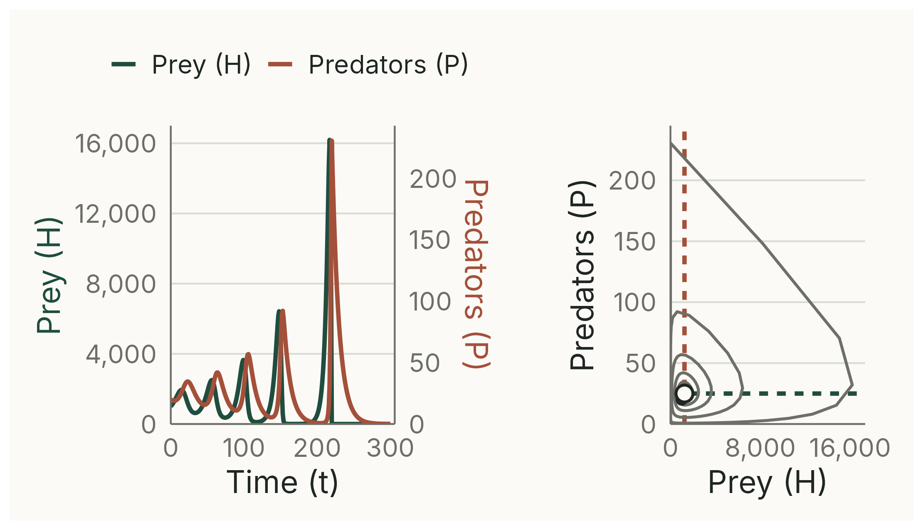
Check your sheet
CHECK
t = 1: H = 1050, P = 19.6. t = 2: H = 1106.7, P = 19.286. With dt = 1 the cycles grow, and the prey hit zero at t = 220.
Notes:
(1 min) 0 to 300 time units with dt = 1, as on the worksheet's own graph. The cycles grow until the prey hit zero at t = 220 (they almost do at t = 167, when only about 2 prey are left); the predators then dwindle.
Deterministic simulation of the worksheet model, script 02_check_sheet.R; numbers printed by 00_check_numbers.R.

Slide 4
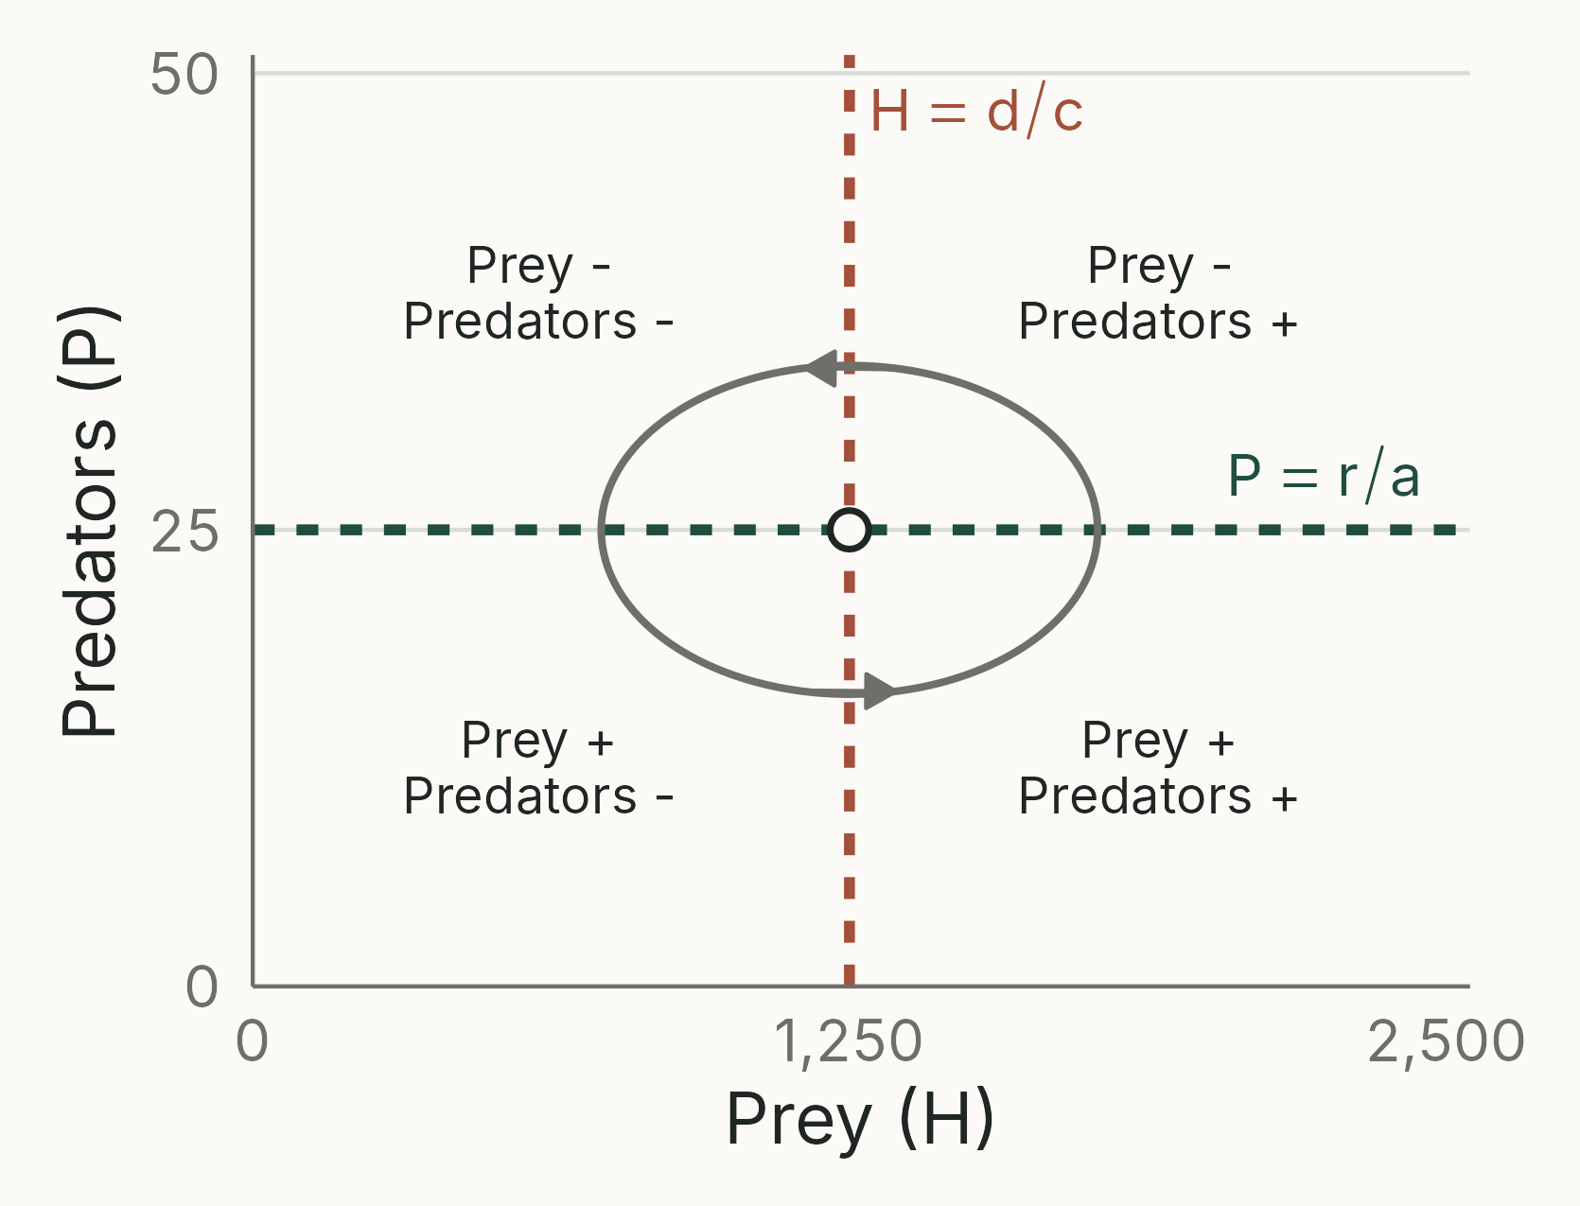
What your phase graph can show
Prey isocline: P = r/a
Predator isocline: H = d/c
+ and − show which way each population changes
Equilibrium where the lines cross: (1250, 25)
Notes:
Reference for Part 2 (put it up if pairs are stuck on the direction of the cycles). Right, up, left, down: anticlockwise with prey on the x-axis. Predators peak about a quarter of a cycle after the prey.
Drawn with the worksheet values (r/a = 25, d/c = 1250). Analytical schematic, script 01_isoclines.R.

Slide 5
Answers: try first
Notes:
Show at the end of each session (Part 2 answers after session 1; Parts 3 and 4 after session 2). The numbers match the book's solutions.

Slide 6
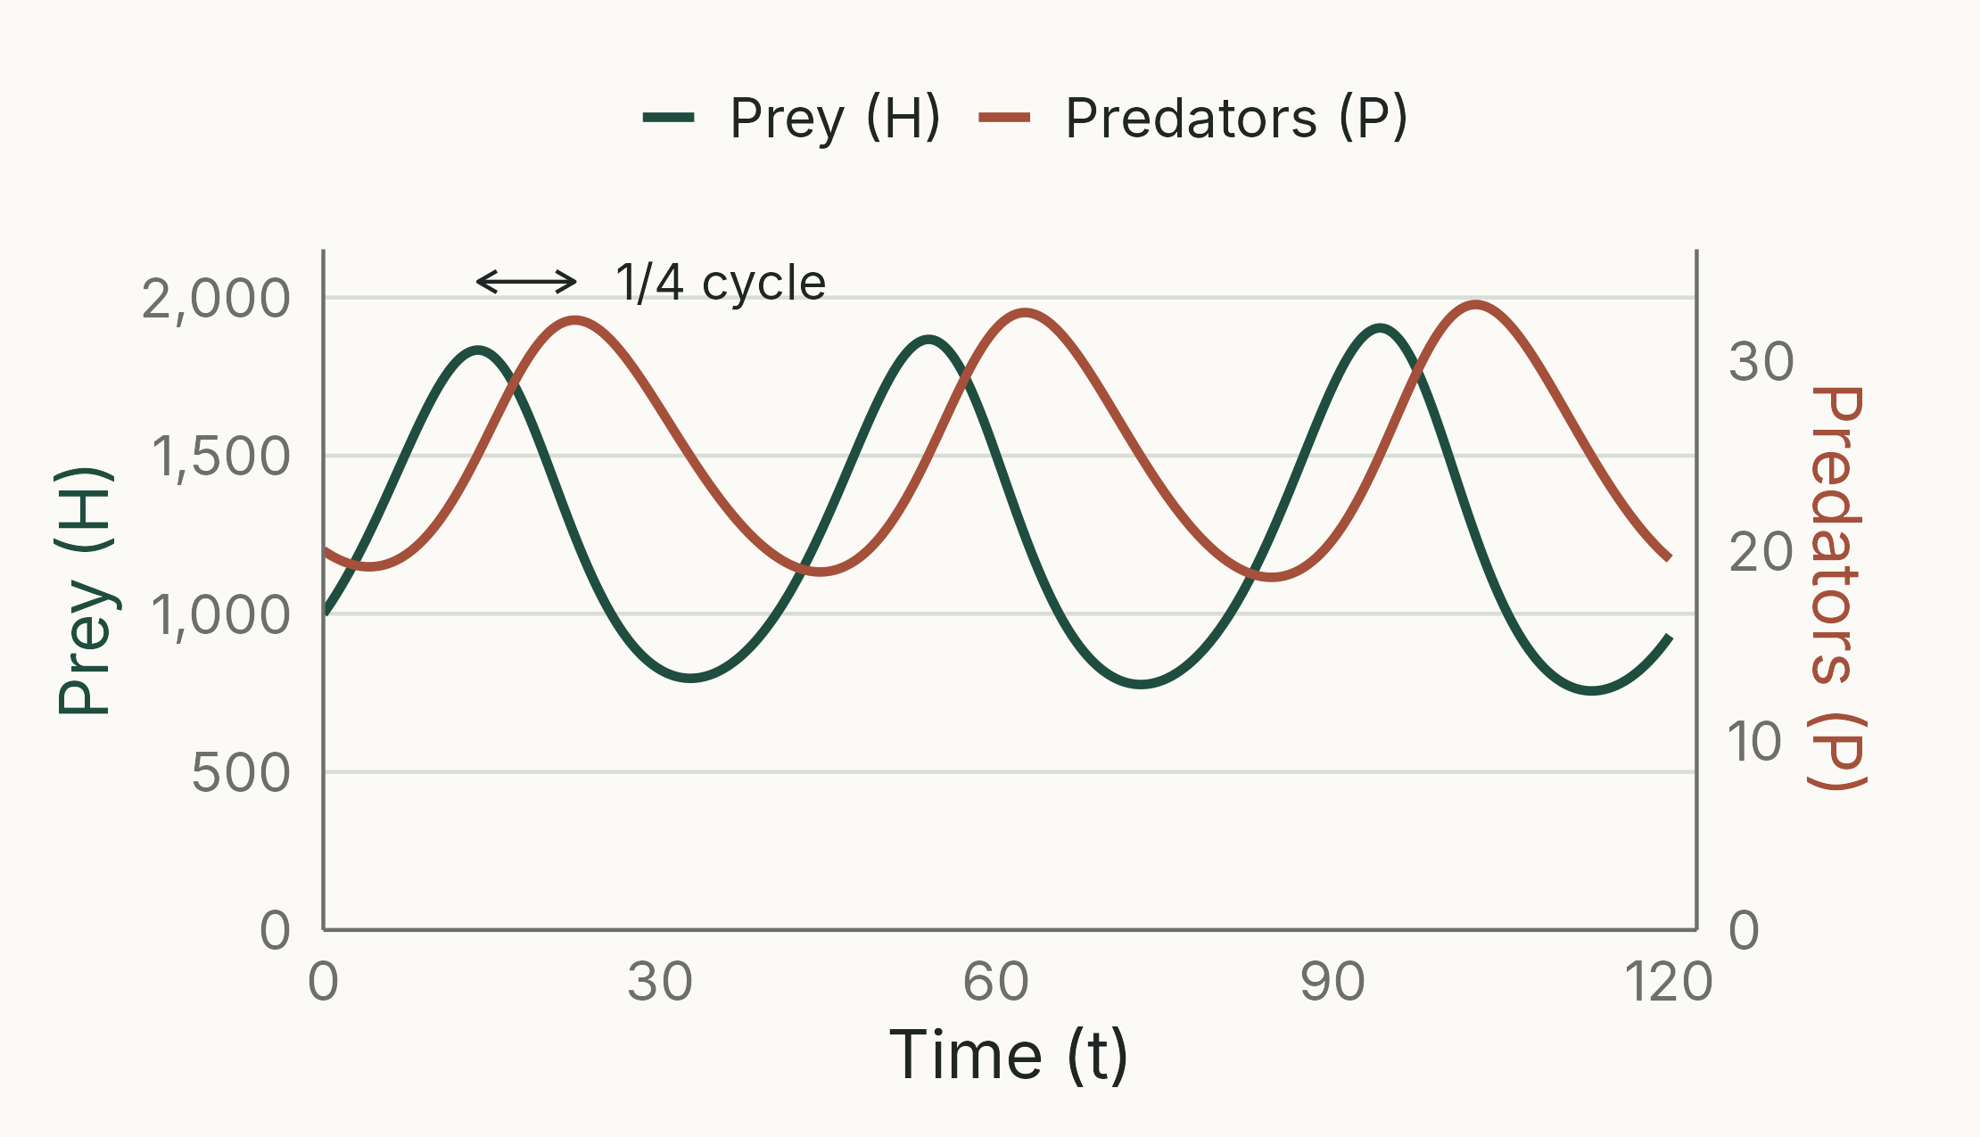
Predators lag a quarter of a cycle
WHY
Prey grow while predators are scarce; predators then grow on the plentiful prey, push the prey down, and starve. One cycle is about 40 time units (2π/√(rd) = 39.7).
Notes:
(2 min) Task 1. With dt = 0.1 (close to the continuous model): prey peaks at t = 13.8, 54.0, 94.2; predator peaks at 22.4, 62.5, 102.7. With dt = 1 the peaks are at 15, 56, 99 and 23, 64, 106.
Phase plane: anticlockwise (slide on the isoclines).
Task 2: starting exactly at (1250, 25) nothing changes.
Deterministic simulation, script 04_answer_cycles.R.

Slide 7
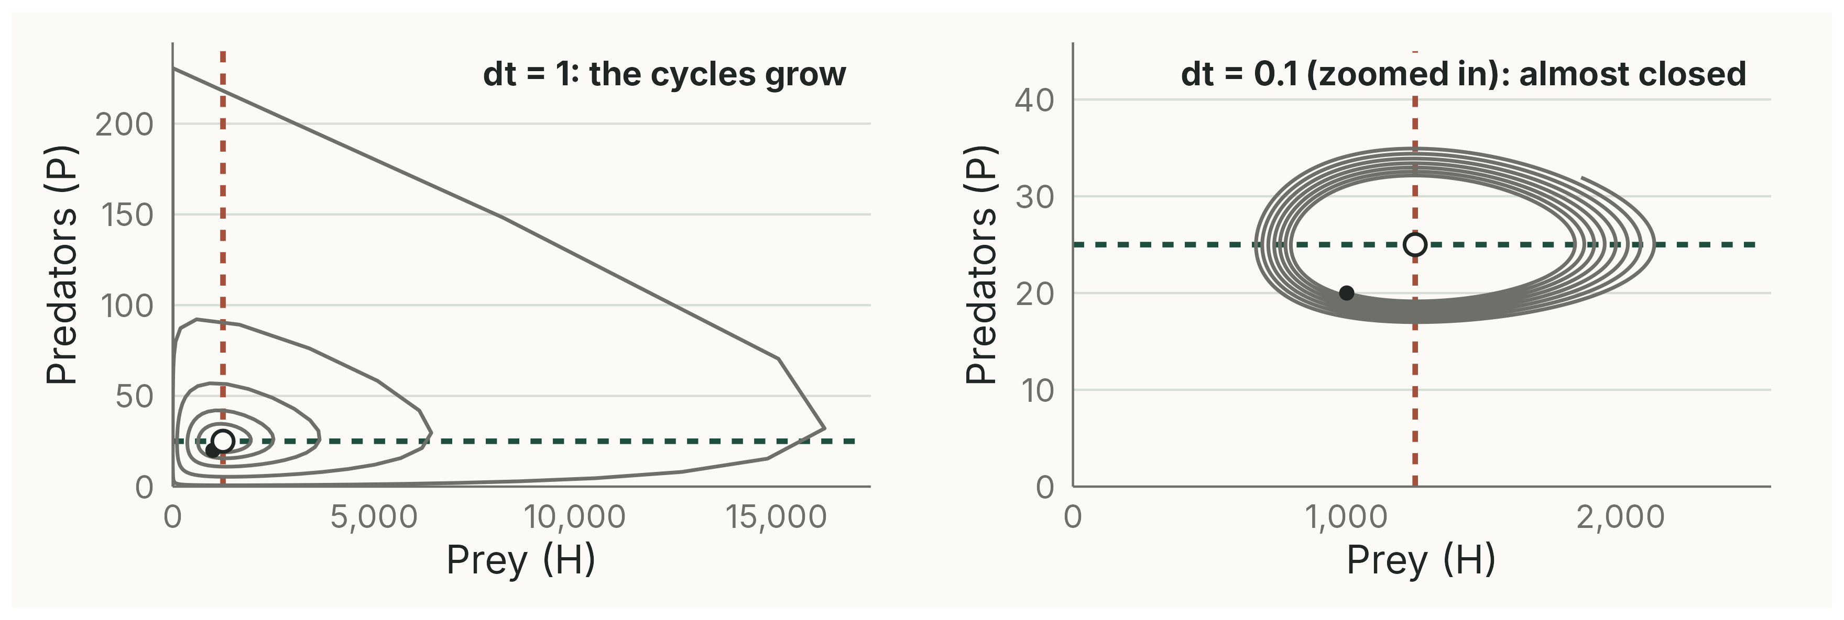
The time step makes the cycles grow
300 time units; right panel zoomed in. dt = 1: prey extinct at t = 220. dt = 0.1: cycles hardly change size.
Notes:
(3 min) Task 3. Each step uses the numbers at the start of the step, so each population reacts too late and overshoots a little more every cycle. Near the equilibrium the distance from it grows by about √(1 + dt²rd) per step: 1.012 (1.2 %) with dt = 1, and almost nothing with dt = 0.1.
dt = 0.5: still grows, no extinction within 300 time units (prey 26 to 5786). dt = 0.1: prey 668 to 2123 over 300 time units.
The continuous model (lecture) has neutrally stable cycles: their size is set by the starting numbers. A small dt is just a more accurate way of calculating it.
Deterministic simulations, script 03_time_step.R.

Slide 8
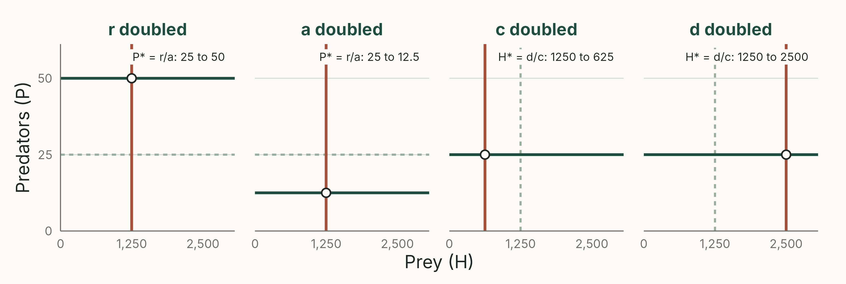
Each parameter moves one isocline
Grey: worksheet values. r and a set the prey isocline (P* = r/a); c and d set the predator isocline (H* = d/c).
Notes:
(2 min) Task 4. Doubling r: P* 25 to 50. Doubling a: P* 25 to 12.5. Doubling c: H* 1250 to 625. Doubling d: H* 1250 to 2500.
Because the start (1000, 20) is then a different distance from the new equilibrium, the cycles also change size.
Optional task 5 (Volterra's principle): r = 0.2 and d = 0.12 move the equilibrium to H* = 1500 (more prey) and P* = 20 (fewer predators).
Analytical schematic, script 05_answer_isoclines.R.

Slide 9
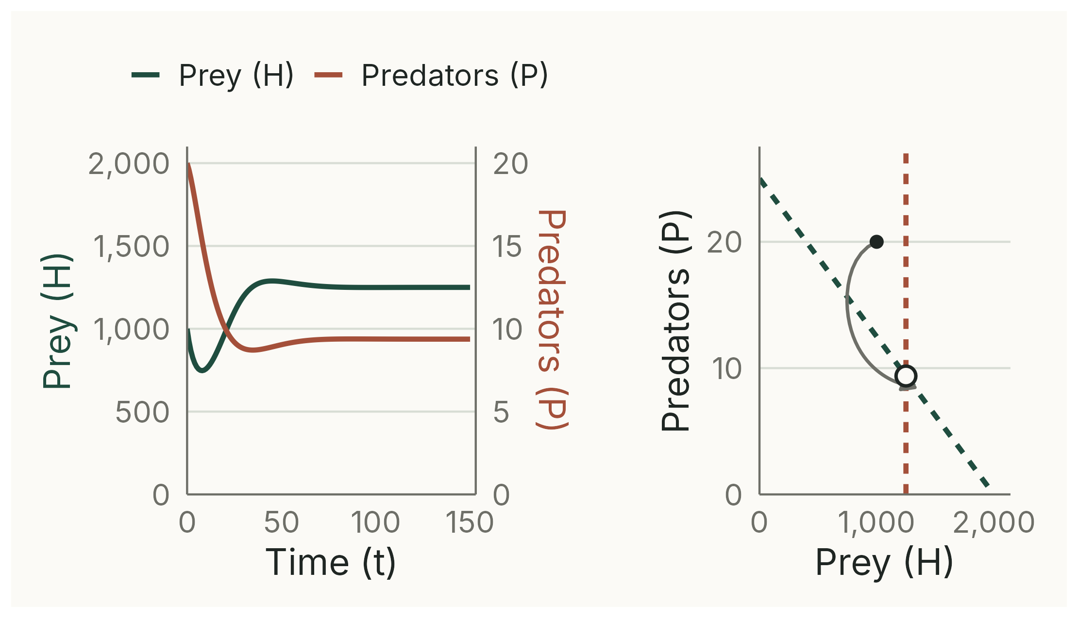
Carrying capacity damps the cycles
WHY
With K = 2000 the populations settle at H = 1250, P = 9.4, where the sloping prey isocline meets H = d/c. Prey self-limitation removes the overshoot.
Notes:
(2 min) P* = (r/a)(1 − H*/K) = 25 × (1 − 1250/2000) = 9.375. Within 1 % of the equilibrium by about t = 66. This happens even with dt = 1.
Deterministic simulation, script 06_prey_K.R.

Slide 10
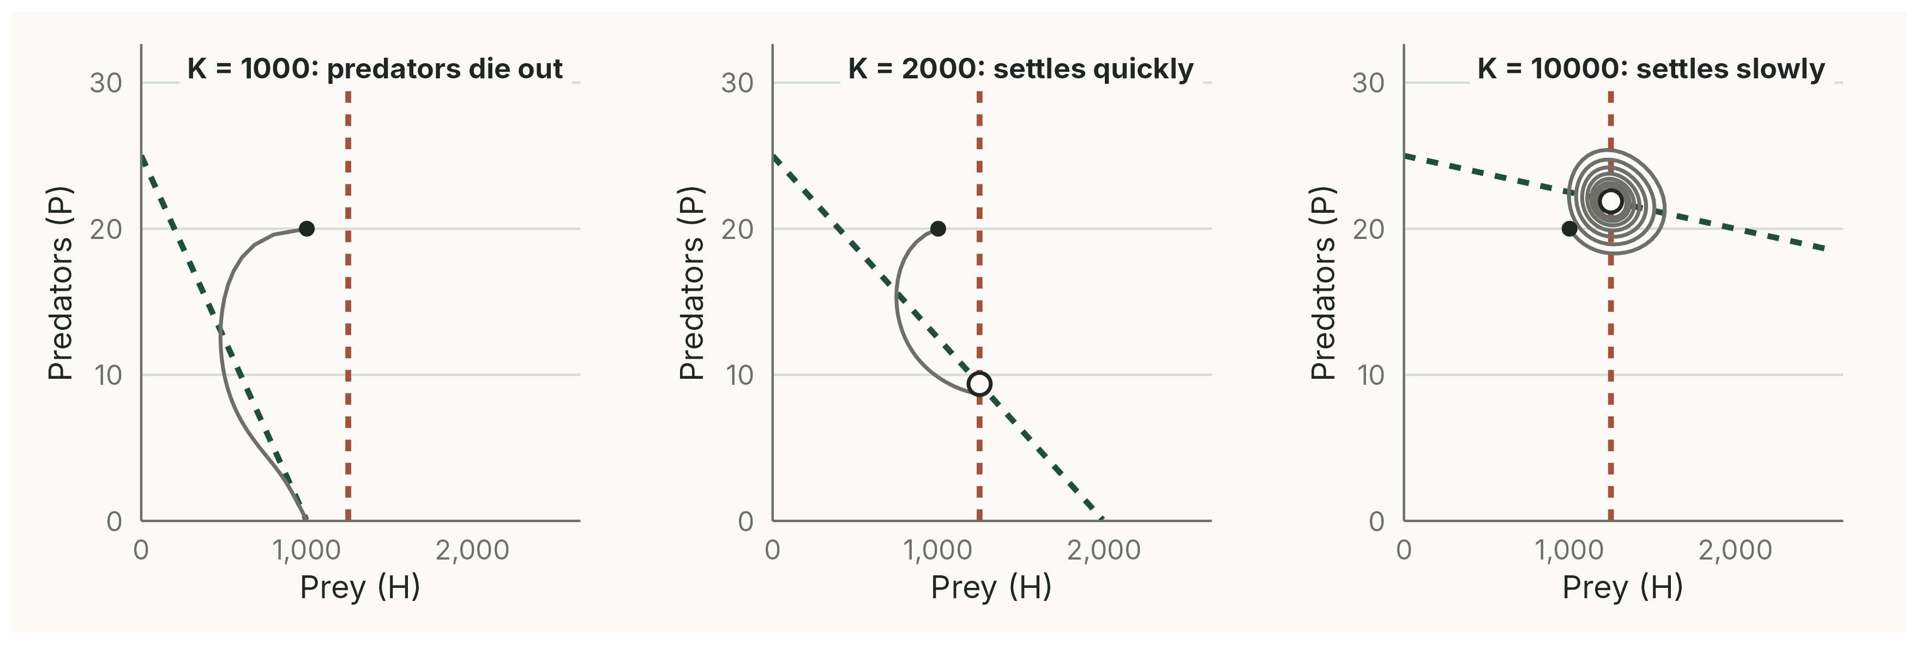
Richer prey environments are less stable
K below d/c: the predators cannot persist. Larger K: more predators at equilibrium, and slower damping.
Notes:
(2 min) K = 1000 < 1250: the prey can never reach the 1250 the predators need; predators fall to about 0.6 by t = 100 and the prey settle at K.
K = 5000: P* = 18.75, settled by about t = 123. K = 10000: P* = 21.875, still cycling slightly at t = 300. Part of this slow settling comes from dt = 1 (with dt = 0.1 it settles faster), but the direction holds in the continuous model too: the larger K, the weaker the damping. H* stays at 1250: enrichment helps the predators, not the prey.
This is the idea behind the paradox of enrichment (Neal), which is much stronger with a Type II functional response (Thomas's lecture).
Deterministic simulations, script 07_K_values.R.

Slide 11
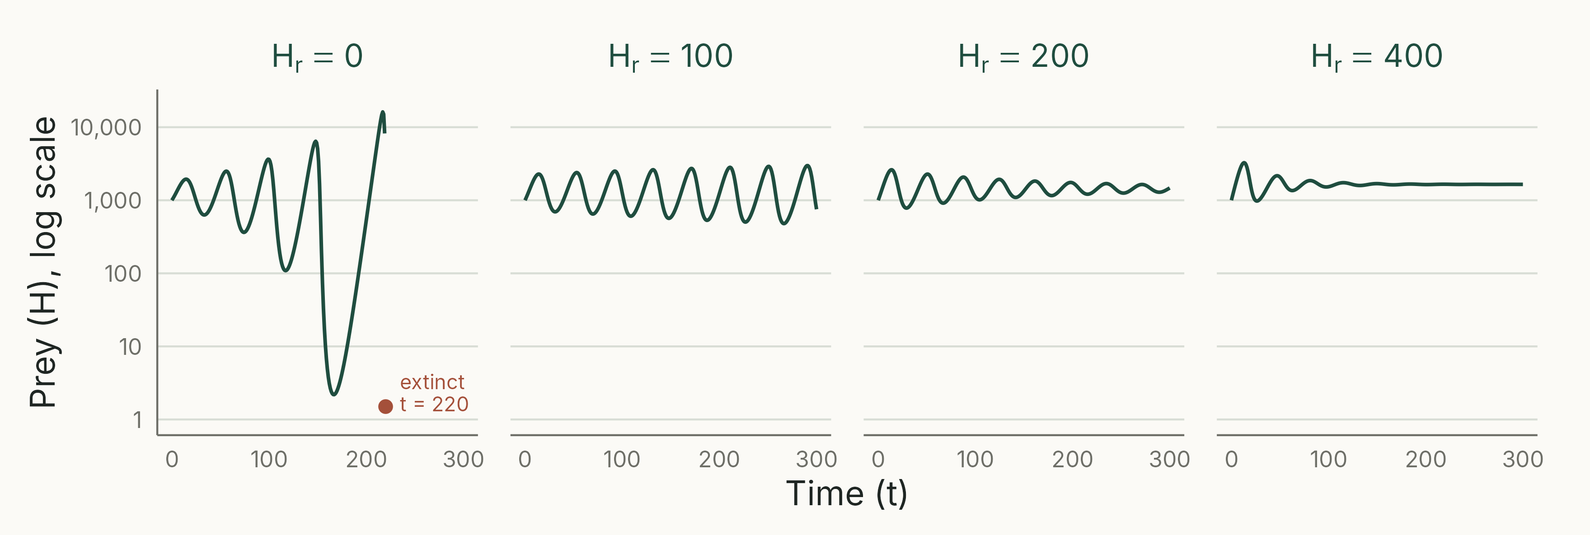
Refuges stop extinction and damp cycles
Prey (log scale), dt = 1. H_{r} = 0: extinct at t = 220; 100: cycles, no extinction; 400: settles at (1650, 33).
Notes:
(2 min) The predators need d/c = 1250 catchable prey, so the predator isocline moves to H = H~r~ + d/c. The prey isocline becomes P = rH/(a(H − H~r~)), rising steeply near H~r~.
H~r~ = 200: cycles shrink (prey 1210 to 1732 in the last 100 time units), equilibrium (1450, 29). H~r~ = 400: within 1 % of (1650, 33) by t = 186.
Deterministic simulations, script 08_refuge.R.

